Slide 1
MySQL Procedures

Slide 2
Introduction
MySQL Stored Procedures and functions are bolstered in version MySQL 5.0. MySQL Stored Procedures is an accumulation of Statements, which permits adaptability and consistence for a software engineer in light of the fact that put away strategy are anything but difficult to execute in the Databases operations.

Slide 3
Introduction
MySQL Stored Procedures are useful where different number of client applications are composed in various languages or it can work on different stages. However they have to perform the same database operations. A store procedure can order another store procedure. In MySQL Stored Procedures, less information will be sent between the user and the server which enhances the execution in the database server.

Slide 4
Introduction
Create procedure is utilized to create a procedure with the procedure name followed by parameters within the parentheses. Parameters can be announced for accessing the Datatypes except few attributes. The procedure can adjust the values however when the procedure gives back the values then alterations is not noticeable to the client.

Slide 5
Syntax
Create Procedure <proc_name> ([proc_parameter[……]]) proc_body
proc_name : Name of the procedure proc_parameter : [ IN | OUT|INOUT] param_name type proc_body : statement in the syntax

Slide 6
Client application – Used to perform a task based on system administration.
Stored procedure – Set of sql statements with an assigned name.

Slide 7
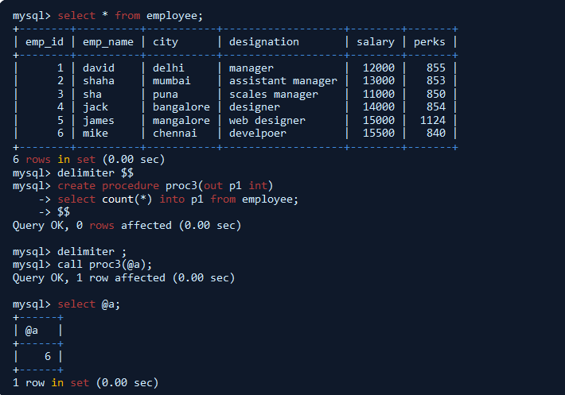
Examples

Slide 8
Examples
In the above example, the procedure proc3 will count all the employees in the employee table from the IN parameter and pass the values to OUT parameter.(i.e, proc3 will count all the emp_id from the table employee and display the output).

Slide 9
Functions

Slide 10
Introduction
Functions is a accumulation of statements, which contains some particular storage in the database server. The function takes a parameter and is utilized to perform an operation by using MySQL and return the outcome set. The function can call a function at any time, once the code is stored in the database.

Slide 11
Syntax
Create Function <func_name>([func_parameter]) returns type function_body
Func_name : Name of the Function Func_parameter : param_name type Type : Any datatype Function_body :statement in mysql

Slide 12
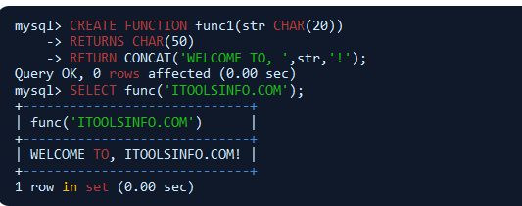
Examples

Slide 13
Examples
In the above example, the function will read the string character and display the output as welcome to ITOOLSINFO.COM.

Slide 14
Drop Procedure
Drop procedure is utilized to drop a procedure. For dropping them privileges are required. IF EXISTS clause is accessible, then it keeps them from causing an error and when the procedure does not exist its produces a notice.

Slide 15
Syntax
Drop {Procedure} [If Exits] {proc_name};
proc_name:name of the procedure.

Slide 16

Example
In the this example, drop procedure will drop the procedure name. (i.e., drop procedure will drop the proc3 name from the database).

Slide 17
Drop Function
Drop function is utilized to drop a function. For dropping them, privileges are required. IF EXISTS statement is accessible, then it keeps from causing a mistake and when the function does not exist it produces a notice.

Slide 18
Syntax
Drop {Function} [If Exits] {func_name};
Func_name:name of the function.

Slide 19

Example
In the this example, drop function will drop the function name.(i.e., drop function will drop the function name func1 from the database.)

Slide 20
Thank You

